Slide 1

Introducing The Elite Graphics Website
SANDILE MDLULI: OWNER & SENIOR DEVELOPER

Slide 2

Website logo
Our First logo Design
Purpose of website is to source clients for my digital design services .
The website is a one-page design with a focus on simplicity and user experience.

Slide 3
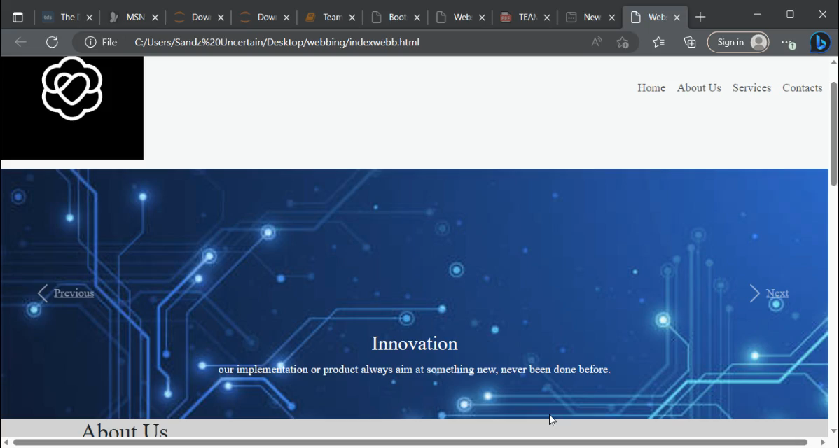
Effortless Navigation and Engaging Carouse
moving carousel adds a dynamic element to the website, showcasing important content or featured products.

Slide 4
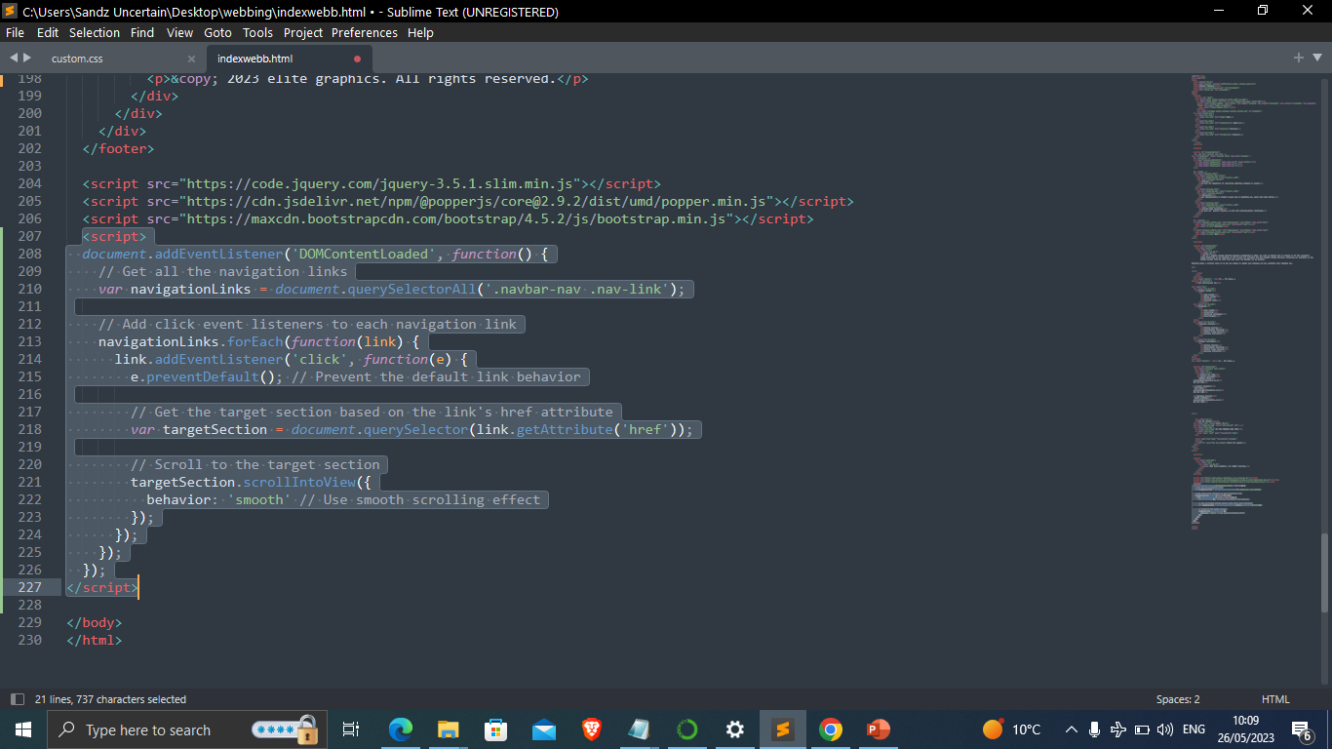
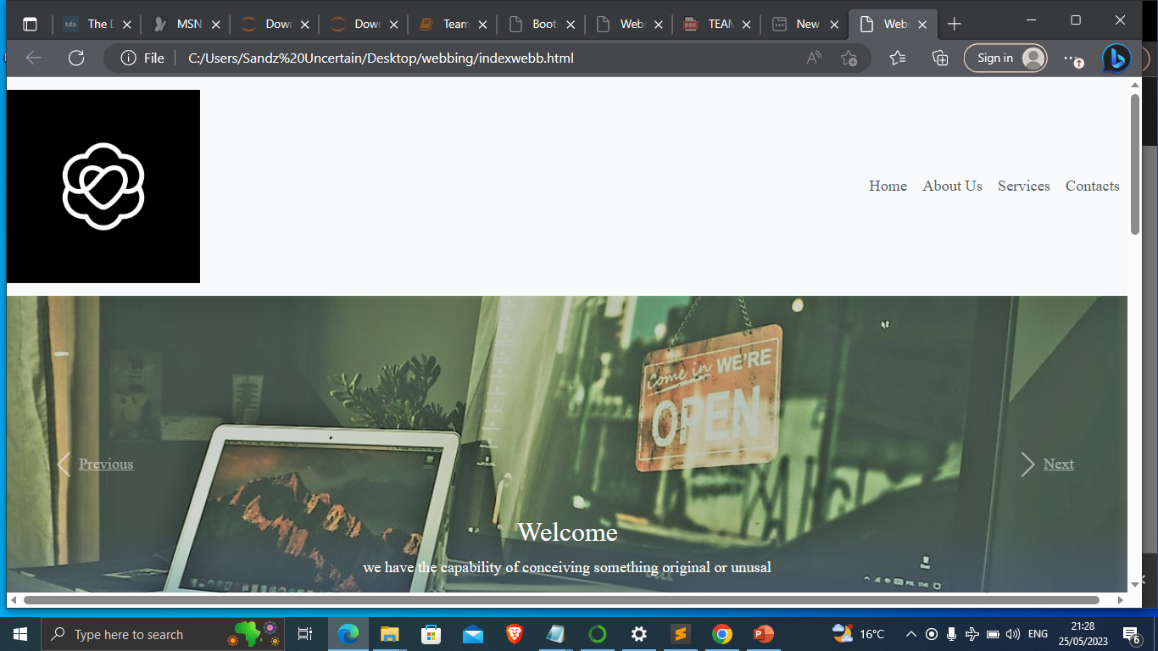
More on landing page
Simple navigation tabs allow users to easily navigate through different sections of the website

Slide 5
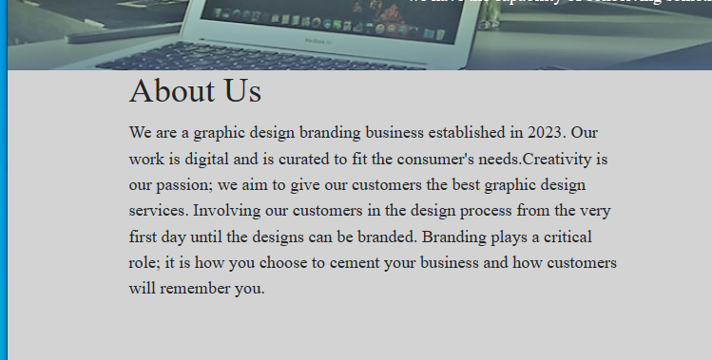
Captivating About Us Story
Reflecting on the importance of storytelling and how it can engage users.
The website features a compelling and concise "About Us" story, enabling visitors to quickly understand our brand and values.

Slide 6
Seamless Contact Experience
Contact details section provides visitors with easy access to your contact information.
the contact form enables users to reach out to you conveniently, For support and sharing their comments
Bootstrap and a custom CSS file to ensure the website's responsiveness, scalability, and customization options were used
Sublime Text Code Editor

Slide 7
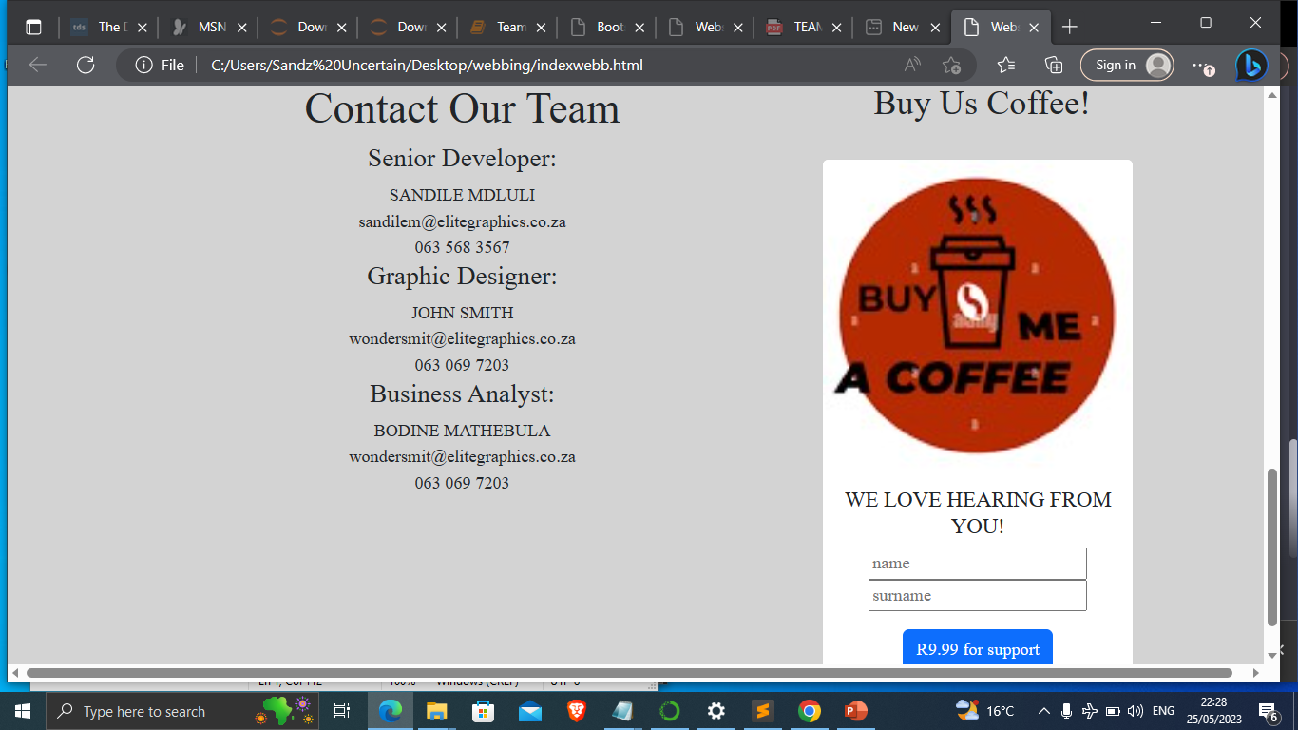

Slide 8

Questions and Comments

